Slide 1
GramiBOT
Chat bot to handle ecommerce orders for Laptop, mobile and television
By: Gaurav, imran, Aakash

Slide 2
Features
The chatbot is made using Gradio’s chat interface at the front-end and Generative AI API is used in the backend.
The user interface provides a chat style product search, addition to the cart and then order.
It supports ordering of the laptops, television and mobile phones.

Slide 3
What is a chatbot?
Chatbots are software applications that use artificial intelligence & natural language processing to understand what a human wants, and guides them to their desired outcome with as little work for the end user as possible.
Like a virtual assistant for your customer experience touchpoints.
A well designed & built chatbot will: – Use existing conversation data (if available) to understand the type of questions people ask.
Analyze correct answers to those questions through a ‘training’ period.
Use machine learning & NLP to learn context, and continually get better at answering those questions in the future.

Slide 4
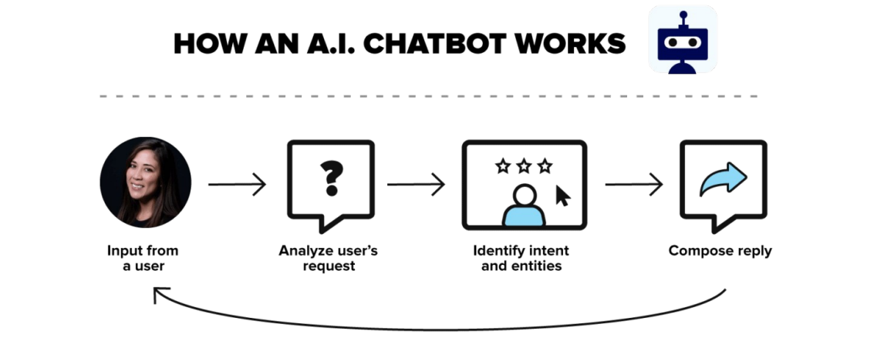

Slide 5
Why chatbot?
Today’s marketing & sales teams are under a lot of pressure to not only show results, but to constantly be improving the customer experience.
It’s a big task. Not to mention the ever-increasing expectations of todays consumers (aka, the Amazon effect).
Today, we expect answers immediately and we expect that they will be accurate. This can be done with human beings up to a certain tipping point, then technology has to be the answer. This is why forward thinking brands have adopted chatbots to help them.

Slide 6
GRAMIBOT

Slide 7
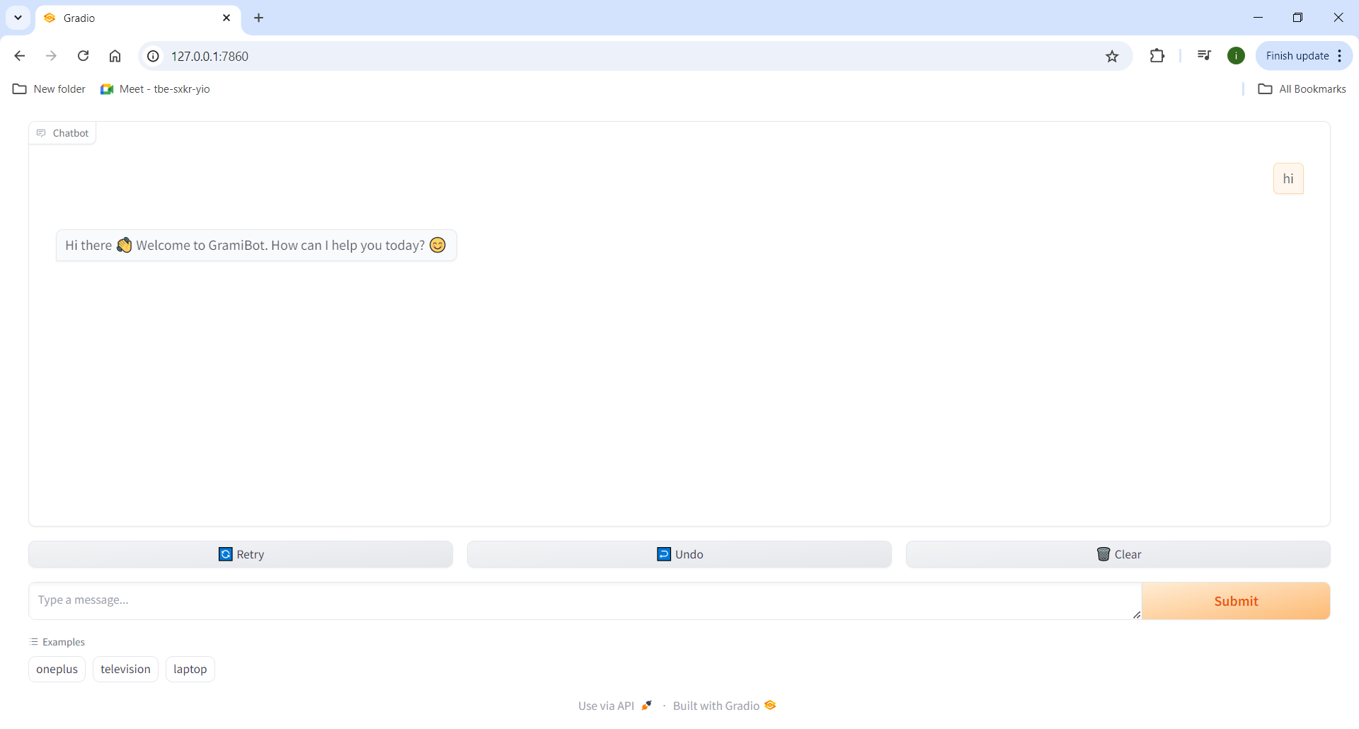

Slide 8
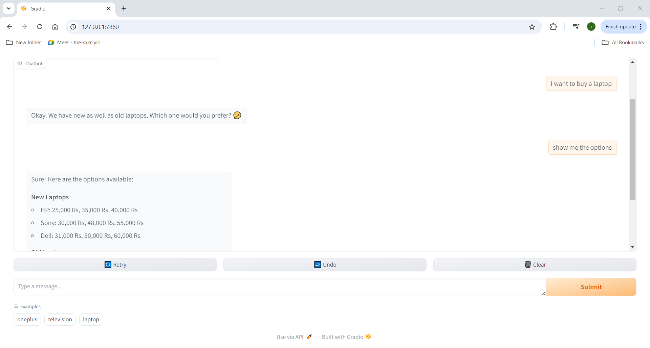

Slide 9
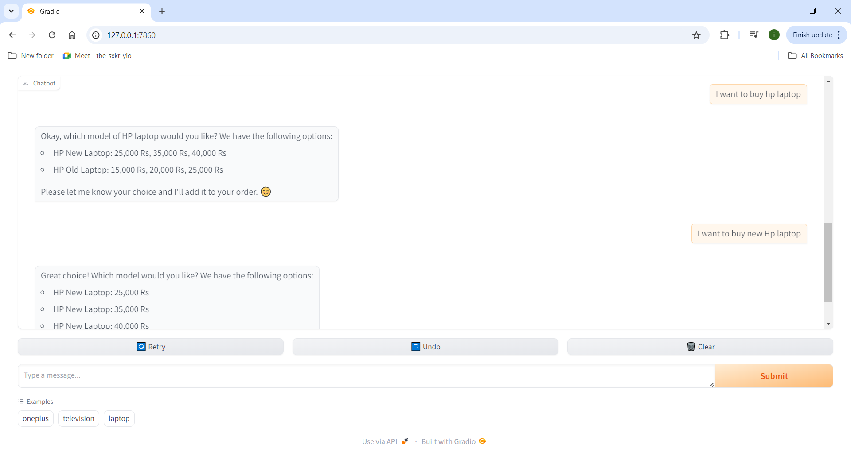

Slide 10
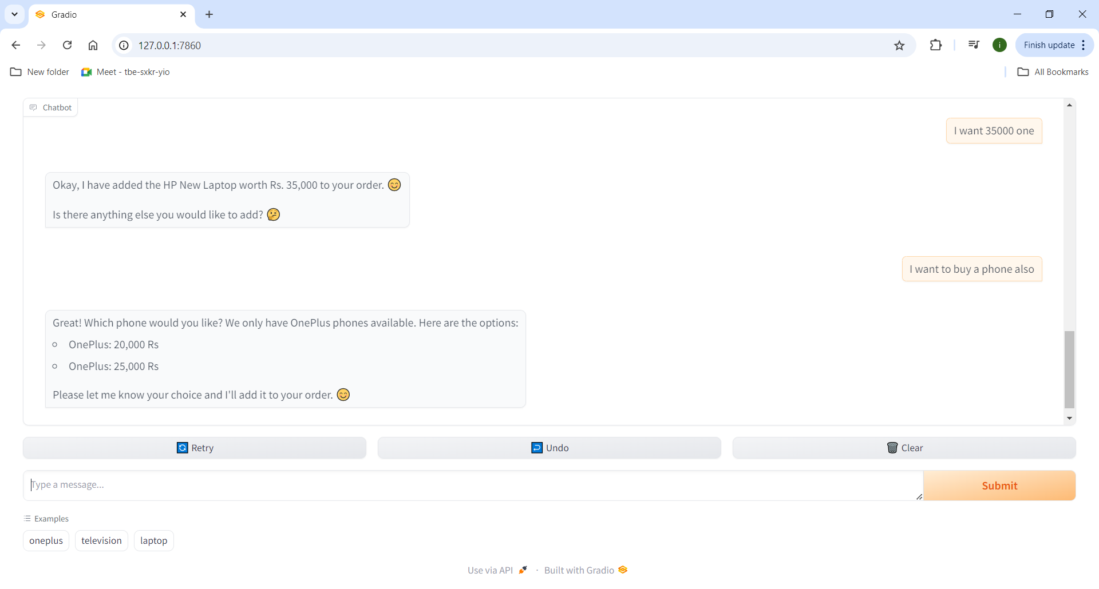

Slide 11
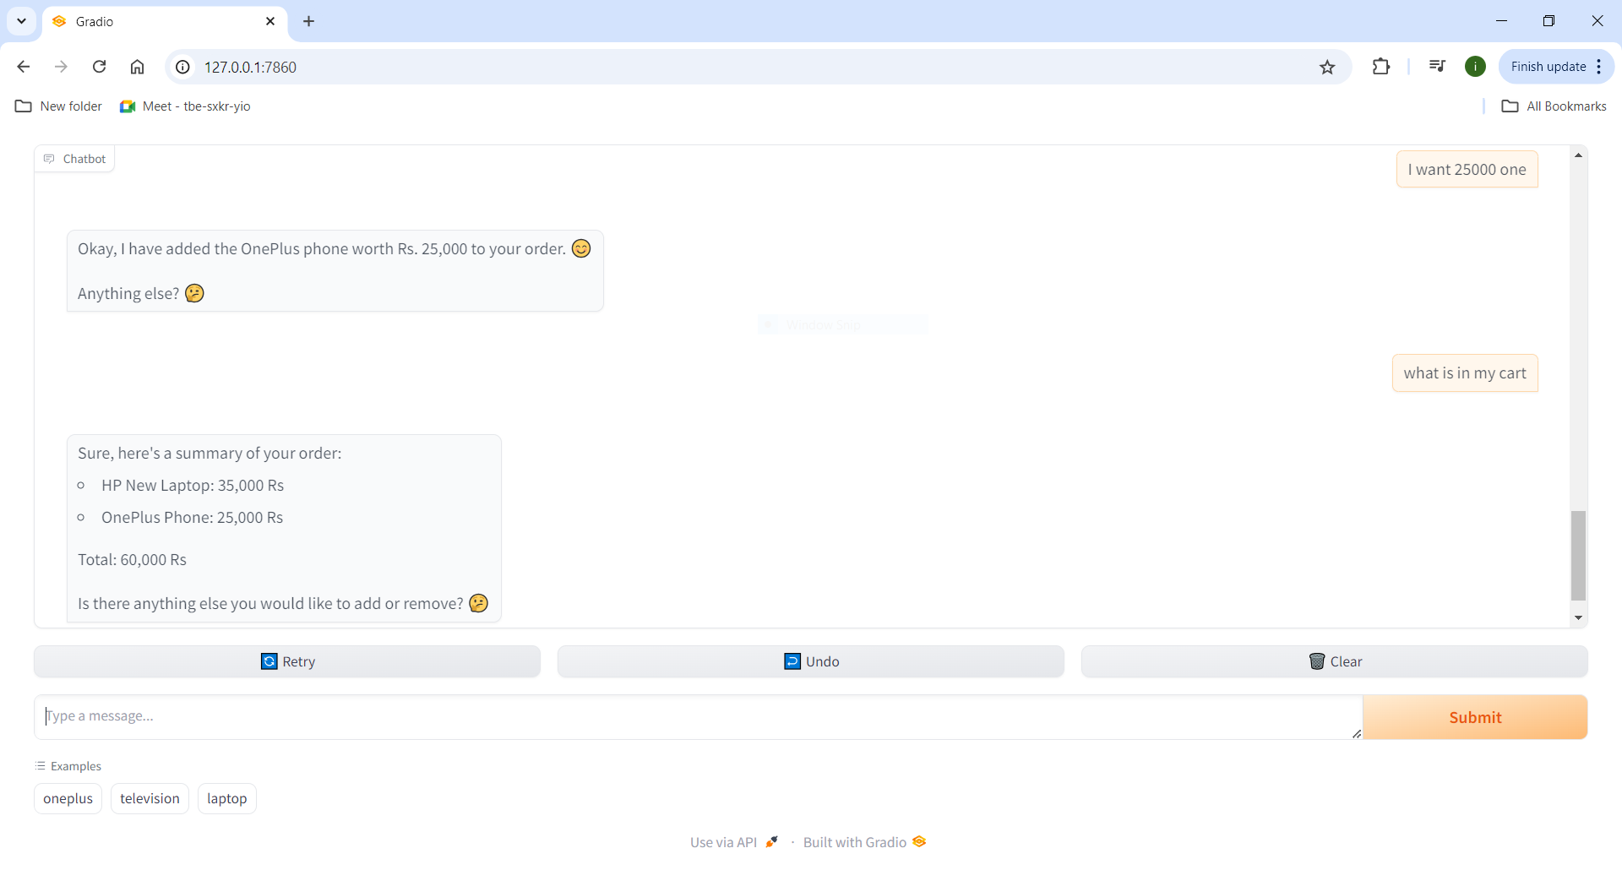

Slide 12
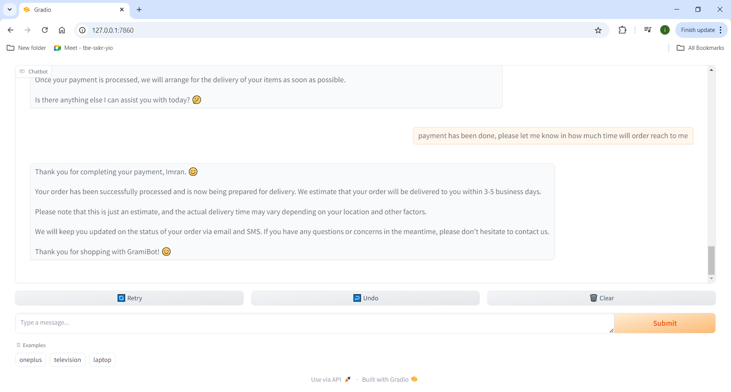
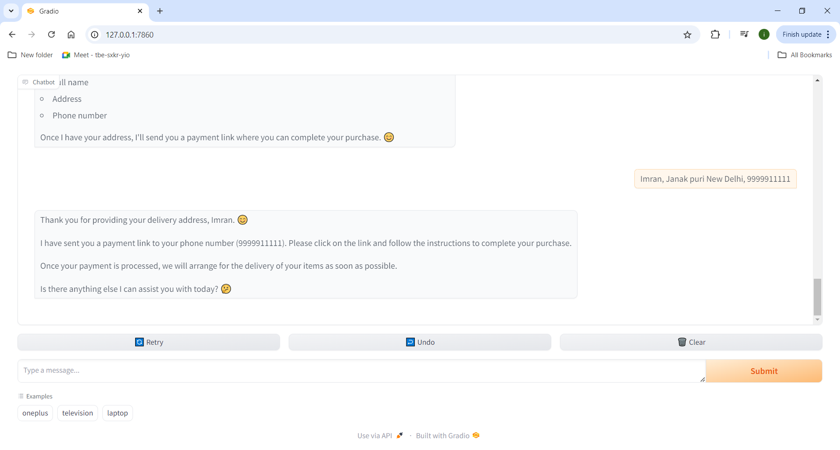
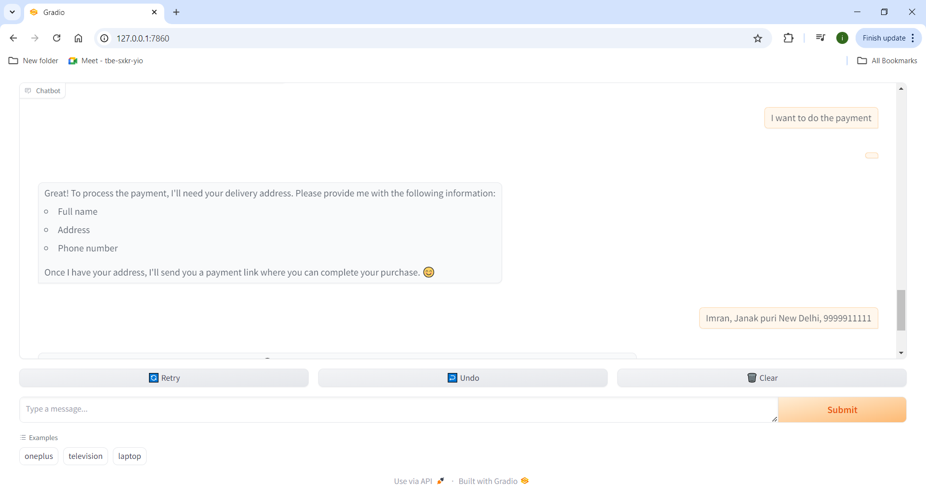

Slide 15
Thank you

